Slide 1
FraudWatch: A Comparative Study on Fraud Detection Techniques
Team :
Prashanth Aripirala(PA500)
Rishik Shekar Salver(RS2116)

Slide 2
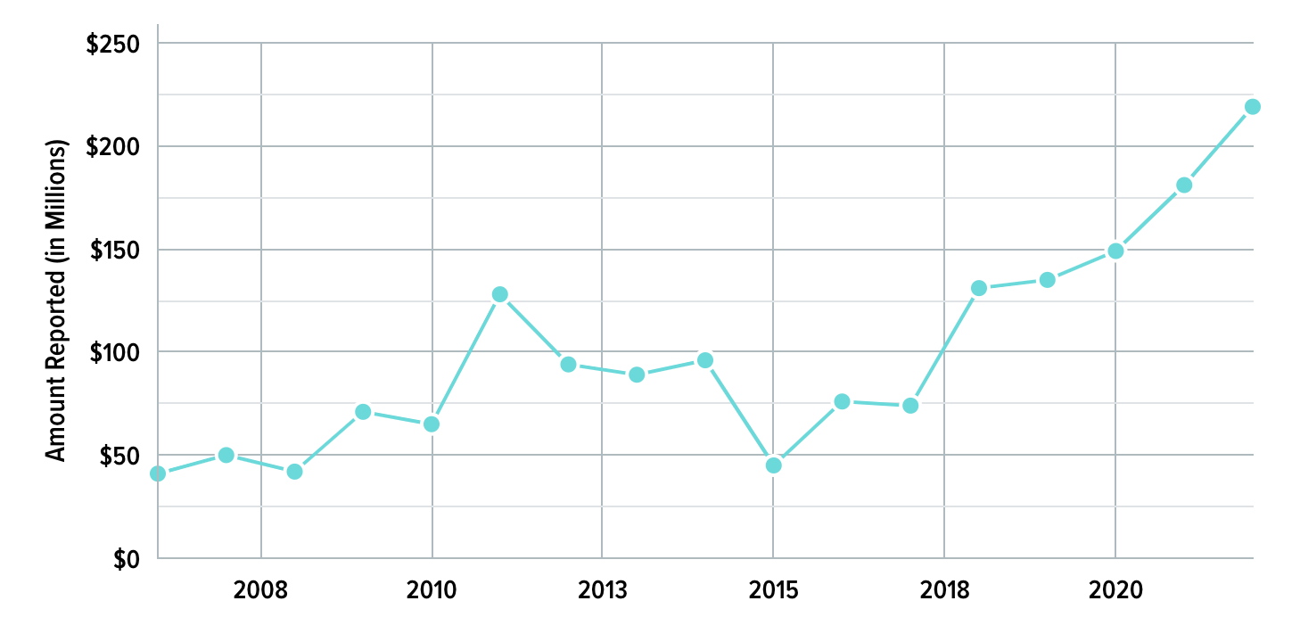
Introduction
Credit card fraud is a persistent threat affecting both financial institutions and individuals.
In 2022 alone, the global losses due to credit card fraud exceeded $34 billion, underscoring the urgency of robust detection methods.
We aim to implement standalone models, and an innovative hybrid model, to enhance credit transaction fraud detection.
By combining machine learning classifiers and anomaly detection techniques,we aim to stay ahead of evolving fraud tactics.
As fraudsters continually adapt, traditional methods alone are no longer sufficient for robust fraud detection.

Slide 3
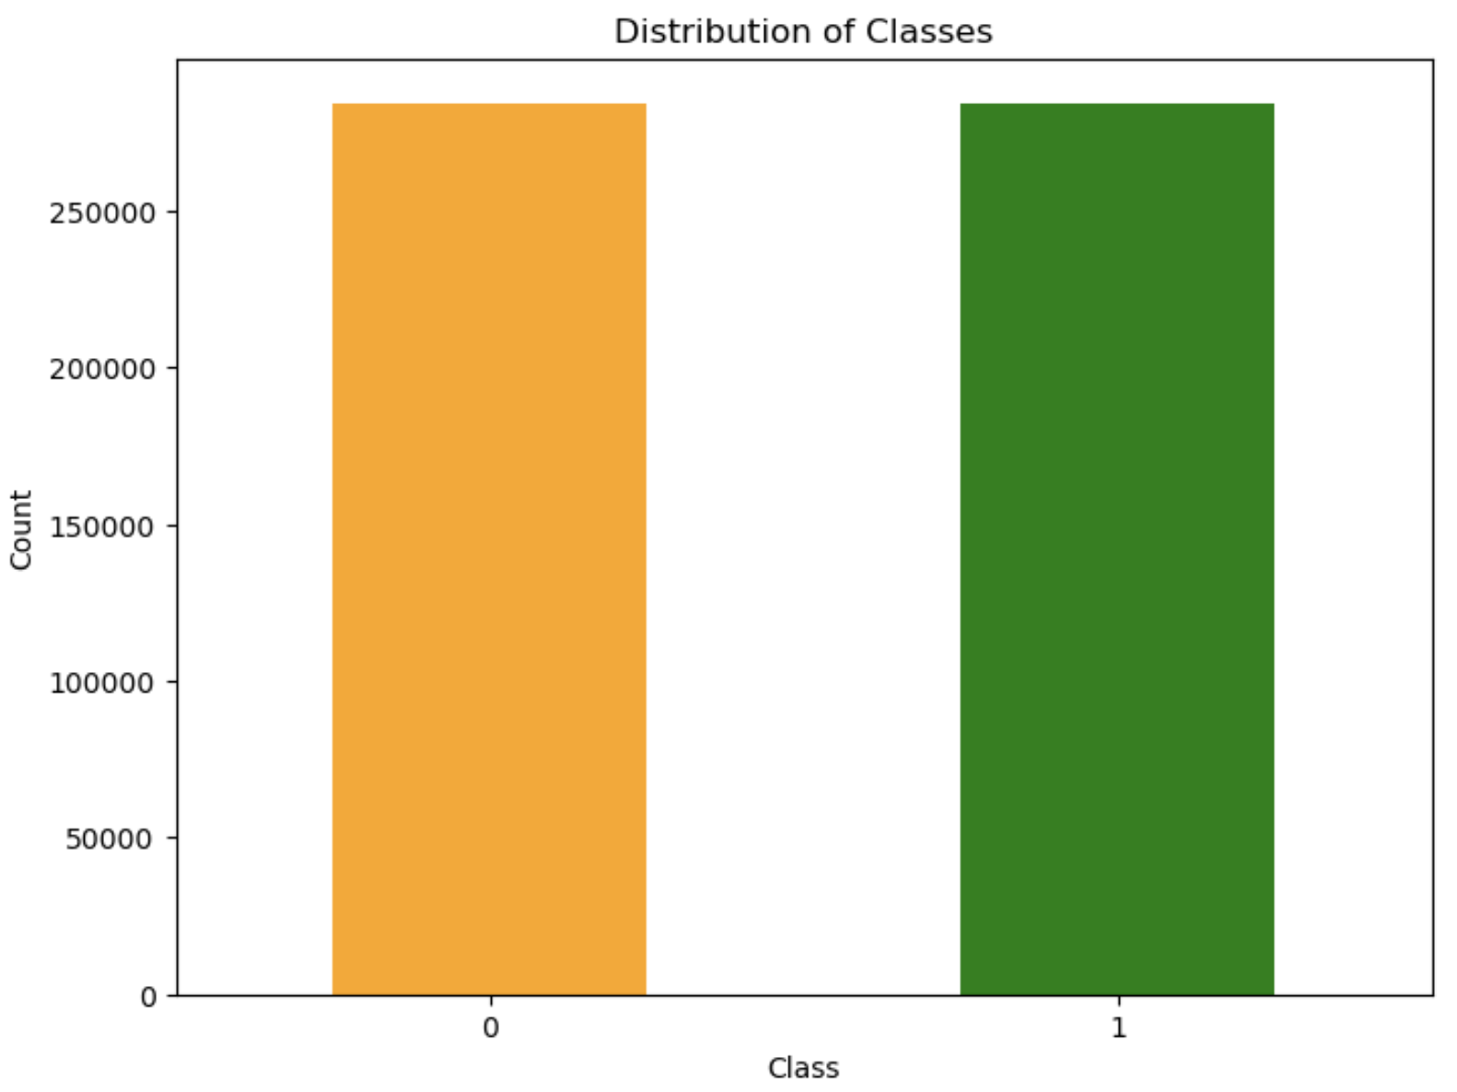
Data Set Overview
The dataset comprises features v1-v28, representing various aspects of credit transactions.
Additional features include the transaction amount and a binary class indicating fraud or non-fraud transactions.
The dataset consists of 568,630 records, offering a comprehensive view of credit transactions.
The class distribution is crucial for context:
Fraudulent transactions: 50% of the dataset.
Non-fraudulent transactions: 50% of the dataset.
Implemented two dimensionality reduction techniques
Feature Selection
Principal Component Analysis

Slide 4
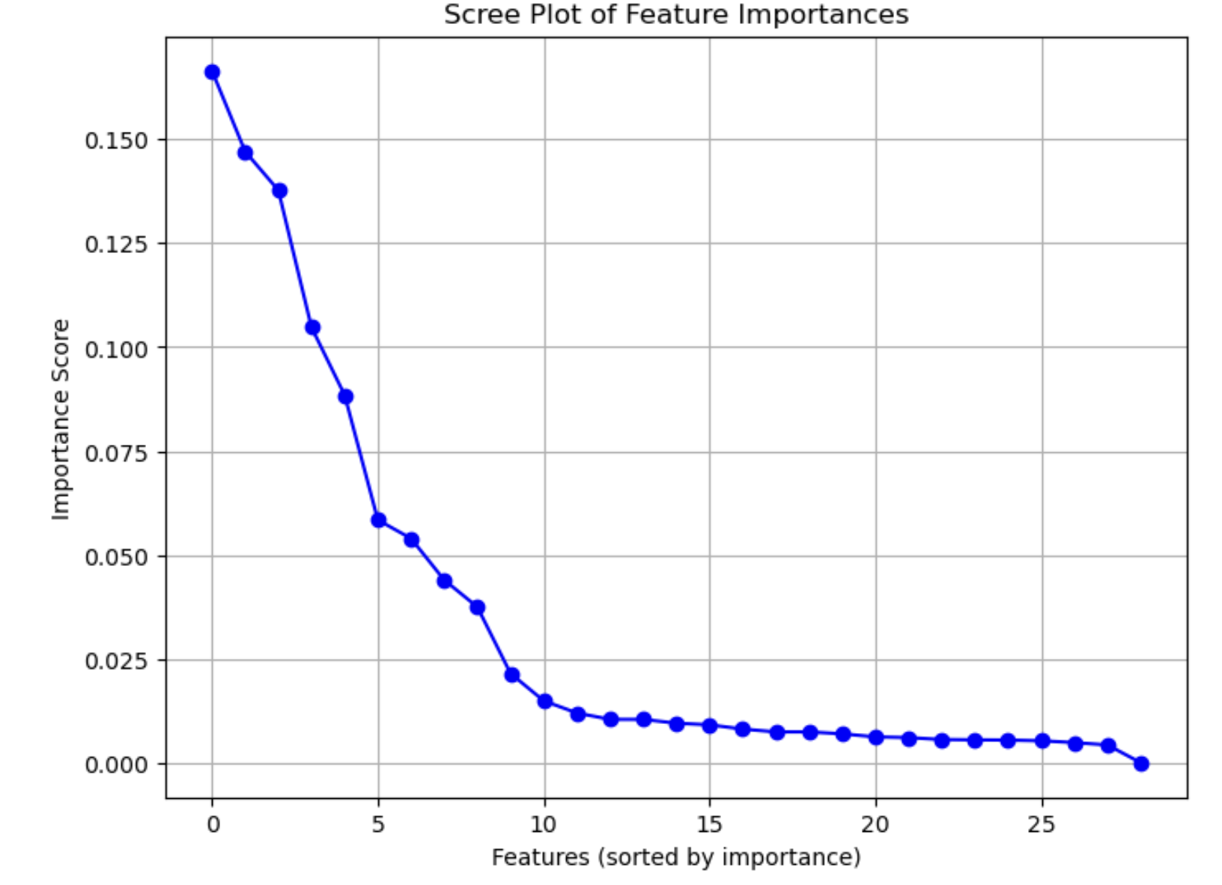
Dimensionality Reduction - Feature Selection
A quick correlation check highlighted that there is a lot of correlation between the variables. So it was necessary to optimize the feature space.
Built a tree based model to perform feature selection, and plotted an elbow plot of feature importances.
The plot demonstrated diminishing returns after the top 10 features, guiding our final selection.
['V2', 'V3', 'V4', 'V7', 'V10', 'V11', 'V12', 'V14', 'V16', 'V17'] are the final set of features.
The focus on the top 10 features allows for improved interpretability and model performance.

Slide 5
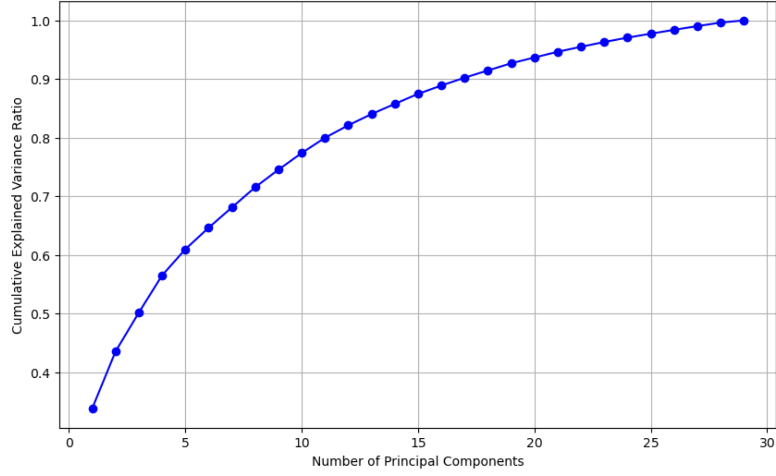
Dimensionality Reduction - PCA
Implemented Principal Component Analysis (PCA) to reduce dimensionality.
Original features v1-v28 and amount were transformed into a set of principal components.
Plotted the variance explained by each principal component.
Identified the optimal number of components to be 17, that contribute to 90% of the total variance.
Conducted a thorough performance comparison between the PCA-transformed dataset and the feature selection dataset.
Despite the effectiveness of PCA, the decision to proceed with the feature selection dataset was based on comparable model performance.

Slide 6
Hypothesis Testing - Amount
A surprising discovery: The feature selection dataset did not include the "Amount" column. To assess its significance, we conducted hypothesis testing.
Hypothesis
Null : There is no significant difference between fraud amounts and non-fraud amounts.
Alternate : There is a significant difference between fraud amounts and non-fraud amounts.
Extracted amounts for both fraud and non-fraud transactions to compare their distributions.
Utilized the Mann-Whitney test to compare distributions.
Obtained a p-value of 0.08 for a significance level alpha of 0.05 suggesting that there is no significant difference between fraud amounts and non-fraud amounts.
While surprising, this finding informs our understanding of the importance of the "amount" variable in fraud detection.

Slide 7
Performance of Classification Models
Implemented three classification models: Logistic Regression, K-Nearest Neighbors (KNN), and Random Forest.
Utilized key evaluation metrics to assess model performance:
Accuracy, Precision, F1 Score, Confusion Matrix
Model/Metric | Accuracy | Precision | F1-Score
Logistic Regression | 0.95 | 0.97 | 0.95
KNN | 0.99 | 0.99 | 0.99
Random Forest Classifier | 0.99 | 0.99 | 0.99

Slide 8
Anomaly Detection
Anomaly detection is a technique that identifies patterns or instances that deviate significantly from the norm in a dataset.
Anomaly detection plays a crucial role in identifying unusual patterns in credit card transactions, allowing for early detection of potential fraudulent activities.
Anomaly detection systems adapt to evolving fraud tactics, providing a dynamic defense against new and emerging patterns without requiring explicit training.
Timely detection of anomalies safeguards customers from unauthorized transactions and financial losses, reinforcing trust in financial institutions.

Slide 9
Anomaly Detection Approaches
Isolation Forest
Isolation Forest, an unsupervised anomaly detection algorithm, efficiently isolates anomalies in high-dimensional datasets, like credit card transactions. During training, it randomly selects features, swiftly splitting data points. Anomalies, with fewer splits than normal instances, are identified, ensuring quick and effective detection of fraudulent transactions deviating from the majority.
One-Class SVM
One-Class SVM, a specialized support vector machine, learns normal instances' representation during training, capturing characteristics of normal transactions. It classifies new instances by measuring their similarity to this learned representation. Anomalies, deviating from this learned representation, are efficiently identified. Valuable for datasets like credit card transactions, One-Class SVM flags transactions with unusual patterns, indicating potential fraud.

Slide 10
Performance of Anomaly Detection Models
Implemented two anomaly detection models: Isolation Forest, One-Class SVM
Utilized key evaluation metrics to assess model performance:
Accuracy, Precision, F1 Score, Confusion Matrix
Model/Metric | Accuracy | Precision | F1-Score
Isolation Forest | 0.913 | 0.919 | 0.912
One-Class SVM | 0.919 | 0.946 | 0.916

Slide 11
Hybrid Model
Passed our train data to fit a Random Forest Classifier.
Obtained the predicted probabilities for both train and test data.
Fed classifier probabilities into anomaly detection model, OneSVM.
Utilized anomaly scores to identify potential fraudulent transactions.
Contrary to expectations, the hybrid model exhibited weaker performance compared to standalone models.
Accuracy | Precision | F1-Score
0.54 | 0.57 | 0.54

Slide 12
Conclusions and Future Scope
Tree-based feature selection provided a focused set of features, contributing to the robust performance of standalone models.
Principal Component Analysis (PCA) yielded limited improvements, and the feature selection dataset outperformed the PCA-transformed dataset.
The hybrid architecture faced challenges, resulting in weaker performance compared to standalone models, highlighting the need for further refinement.
Investigate additional feature engineering techniques to enhance the information captured by the models.
Explore alternative hybrid architectures to address challenges in decision boundary alignment and threshold tuning.

Slide 13
Thank You!!
Any Questions?

